Slide 1
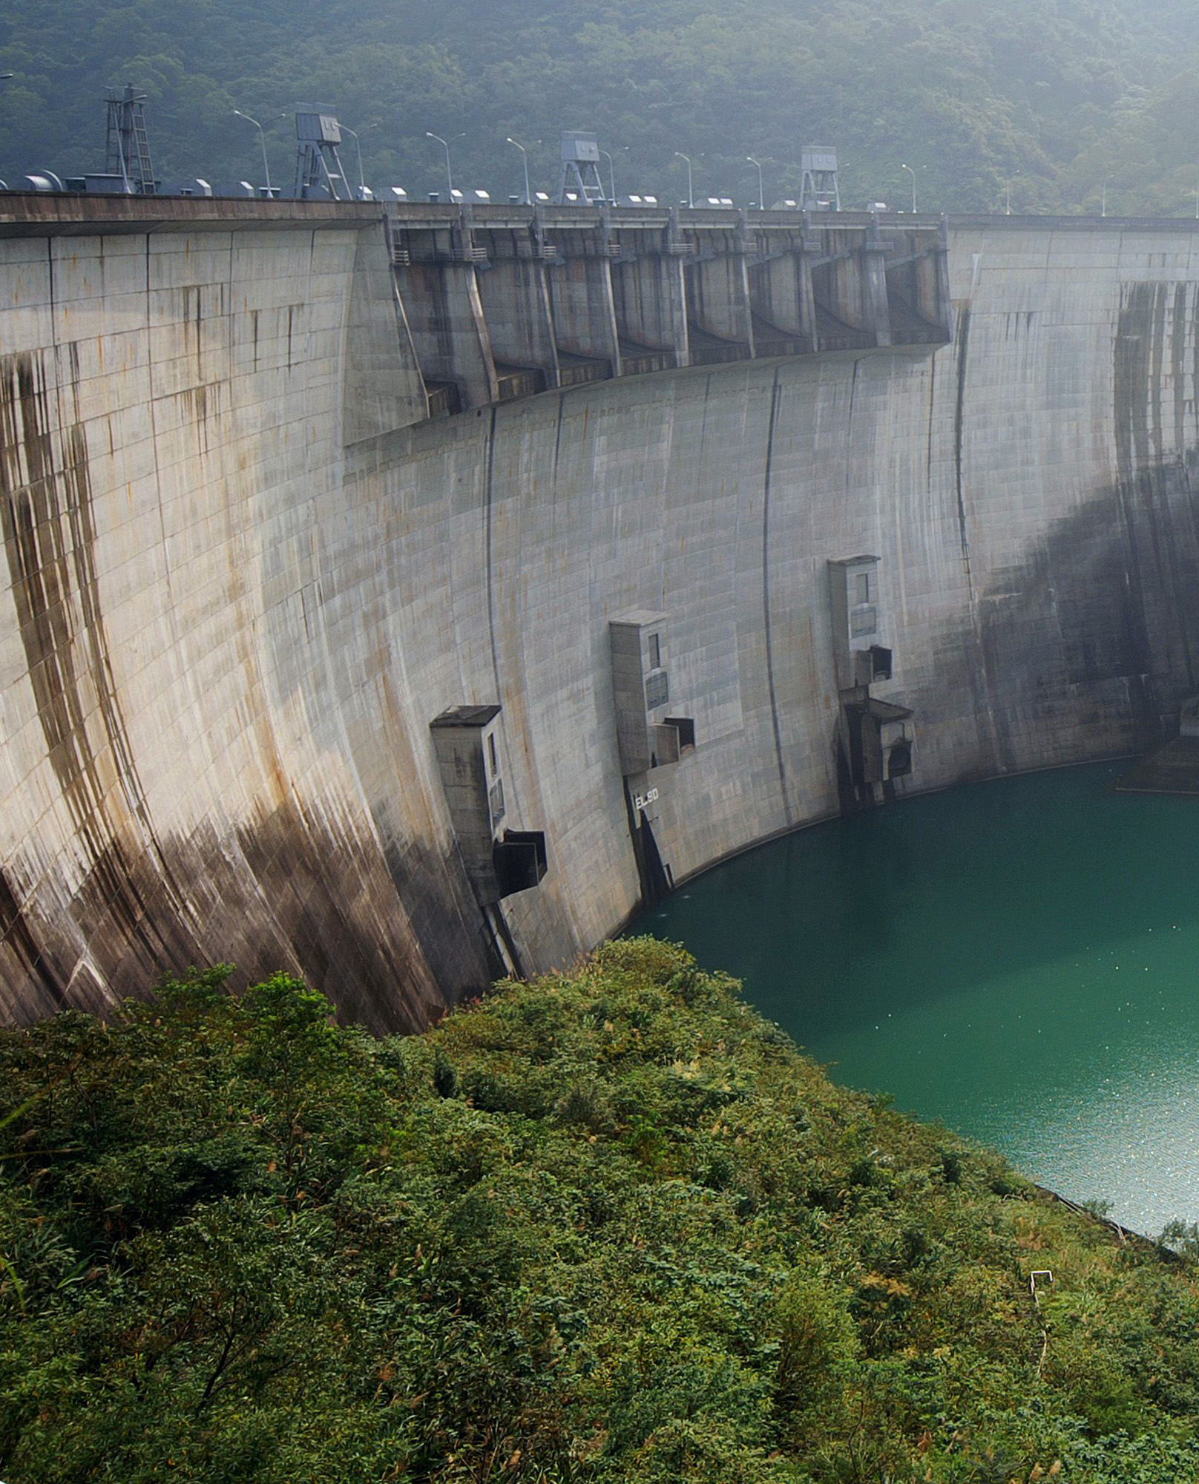
Project 5: Water Management
Seminar ‘Computational Economics‘
Felix Fink
Martin Wicke
Niklas Sayer

Slide 2
Agenda
Motivation
Theory, Implementation
Results
UPDATE!

Slide 3
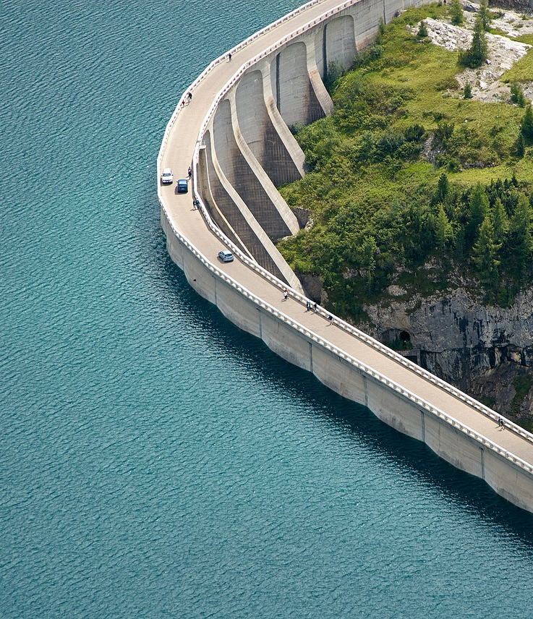
Motivation

Slide 4
Why would that be interesting?
Many regions in the world suffer from physical water scarcity
Population growth, lifestyle changes and climate change will worsen this problem
Higher demand and more volatile weather to be expected
Research suggests that just by managing existing sources of water more efficiently, the arising challenges could be met over the next 50 years

Slide 5
How do we tackle this problem?
One of the most important uses of surface water: Food production -> Irrigation of fields
We model a hypothetical water reservoir with 2 user groups: Farmers and Citizens
Water in the reservoir is replenished by statistically distributed rainfall

Slide 6
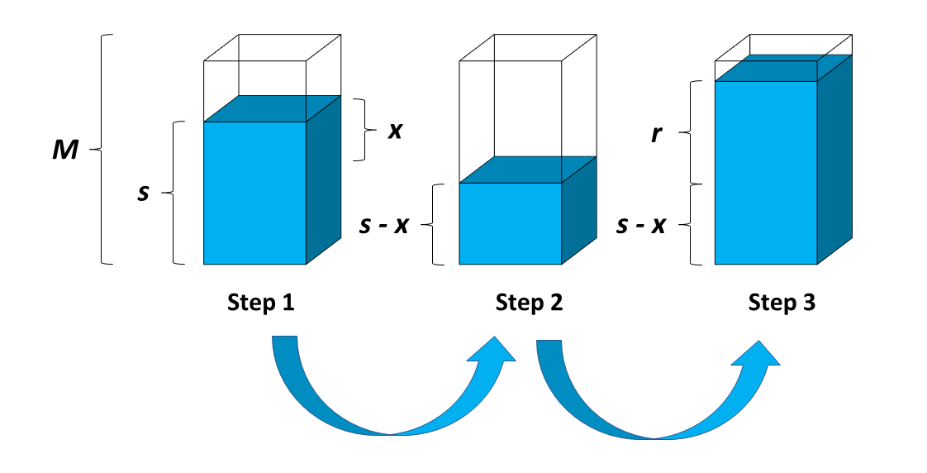
How exactly does that look like?
Goal: Find an optimal irrigation strategy that maximizes the combined utility
Infinite Horizon Dynamic Programming and Monte-Carlo simulation

Slide 7
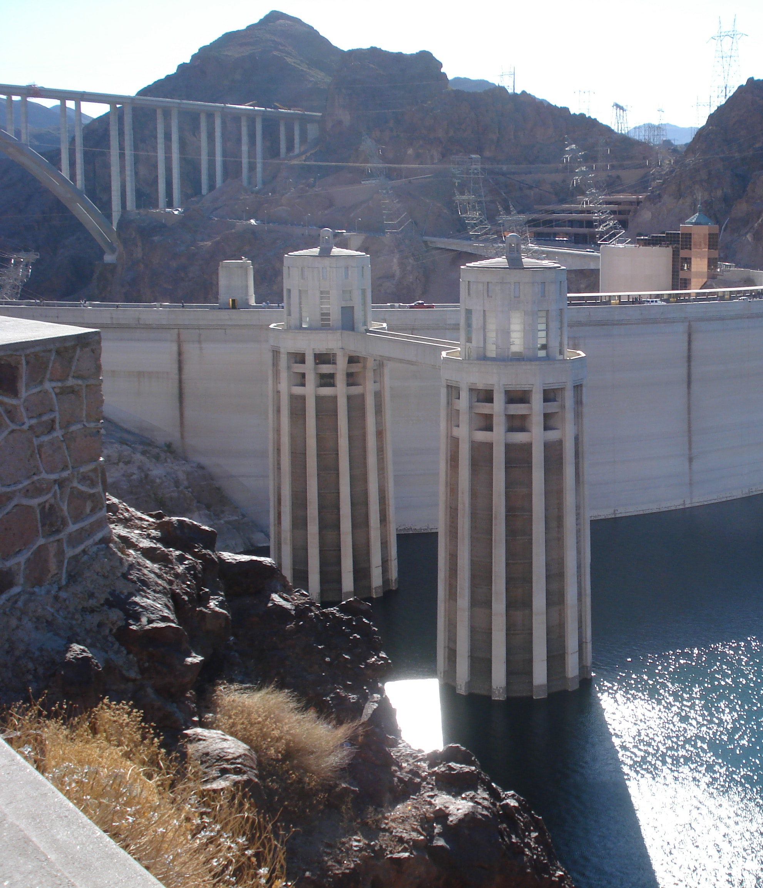
Theory

Slide 8
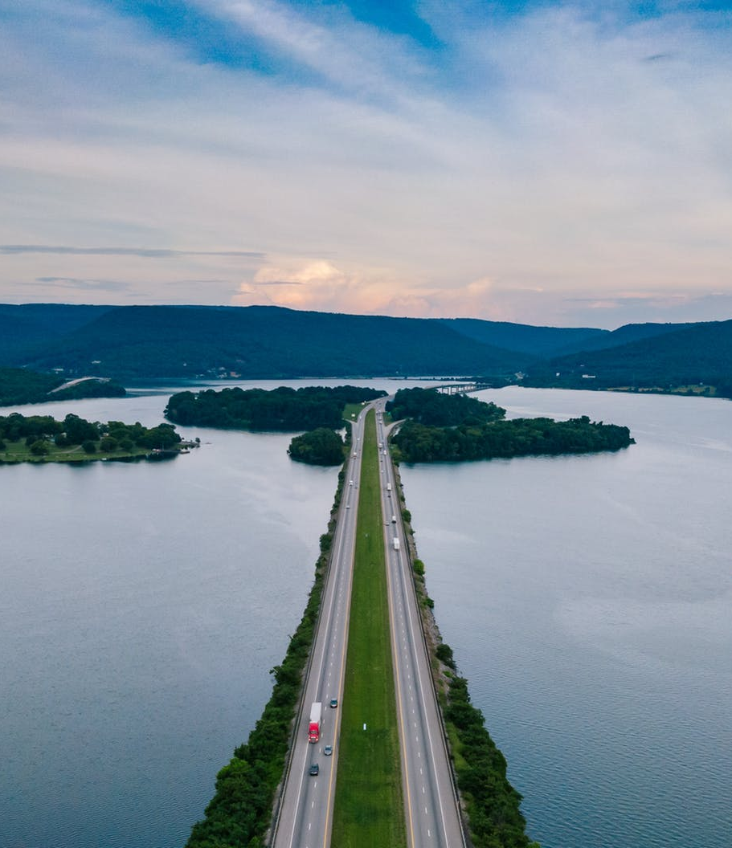
Results

Slide 9
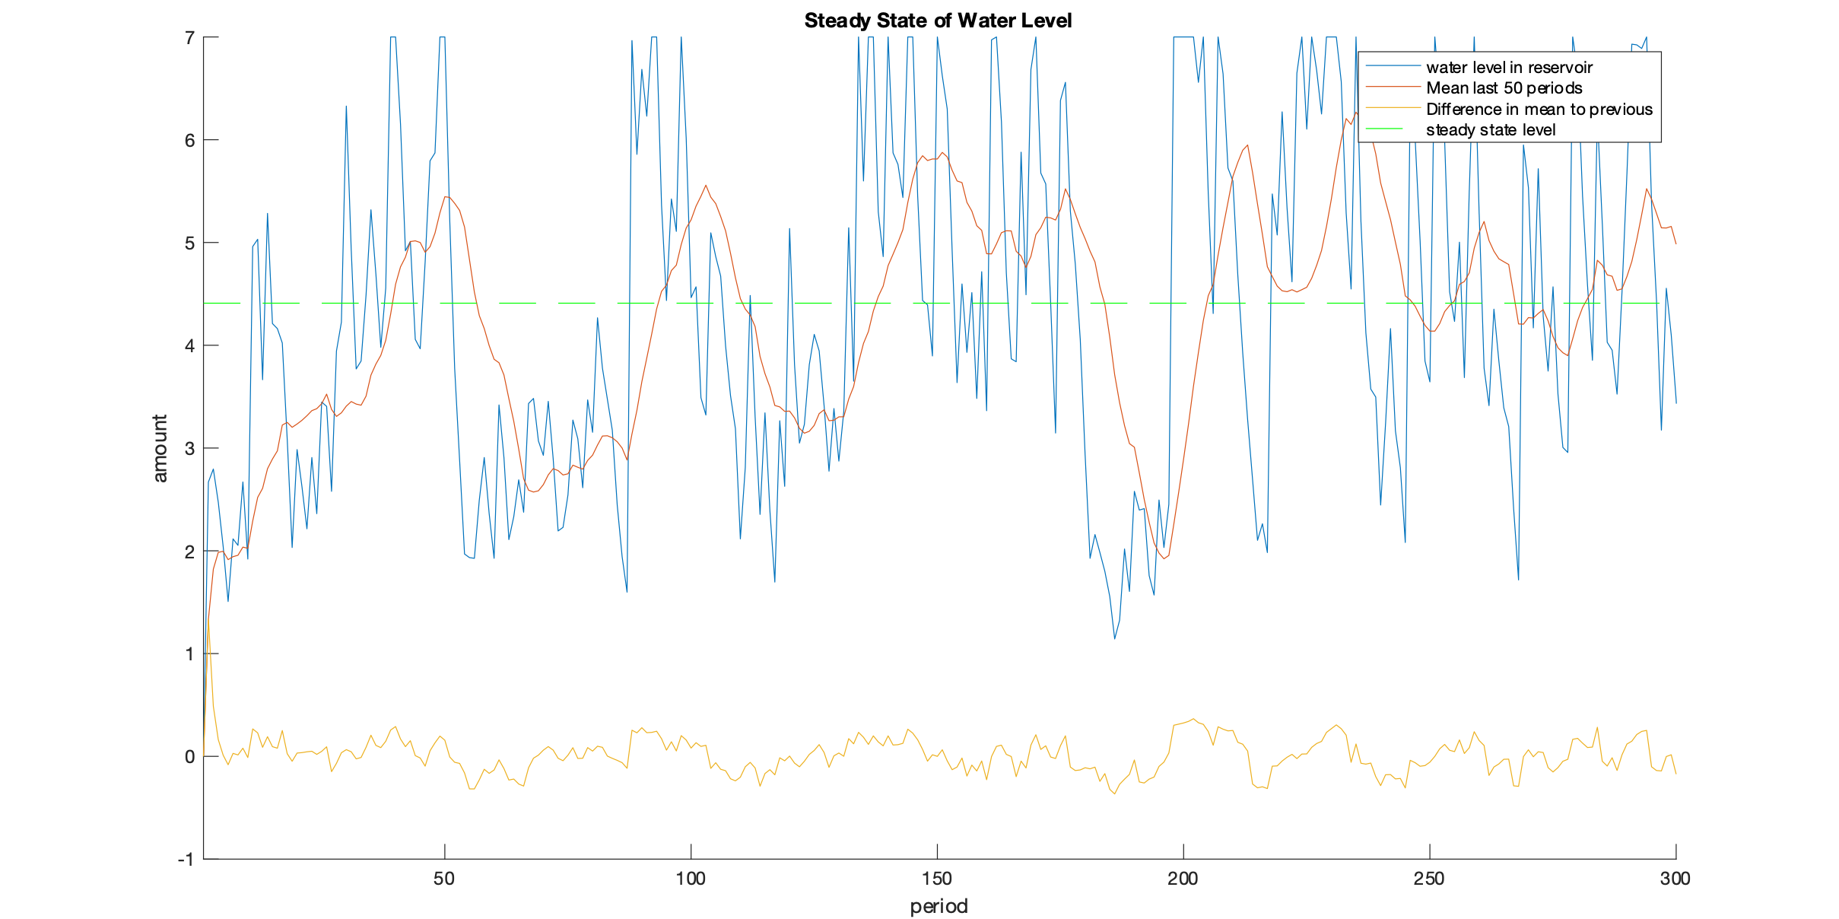
What is the steady state Level of the reservoir?

Slide 10
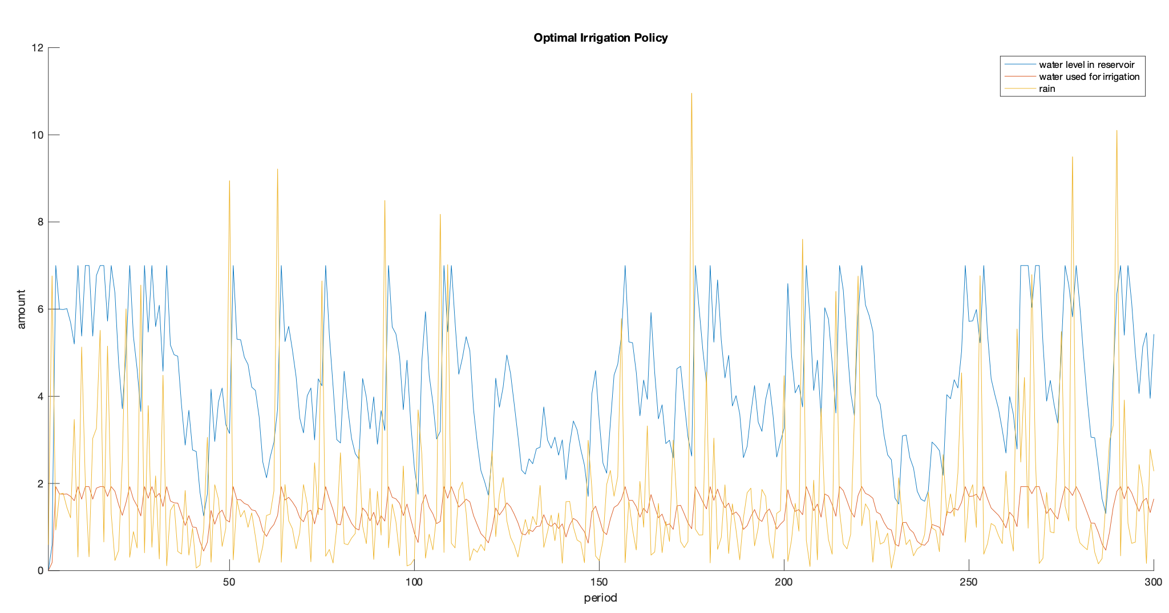
What irrigation policy maximizes the sum of utilities of farmers and recreational users?

Slide 11
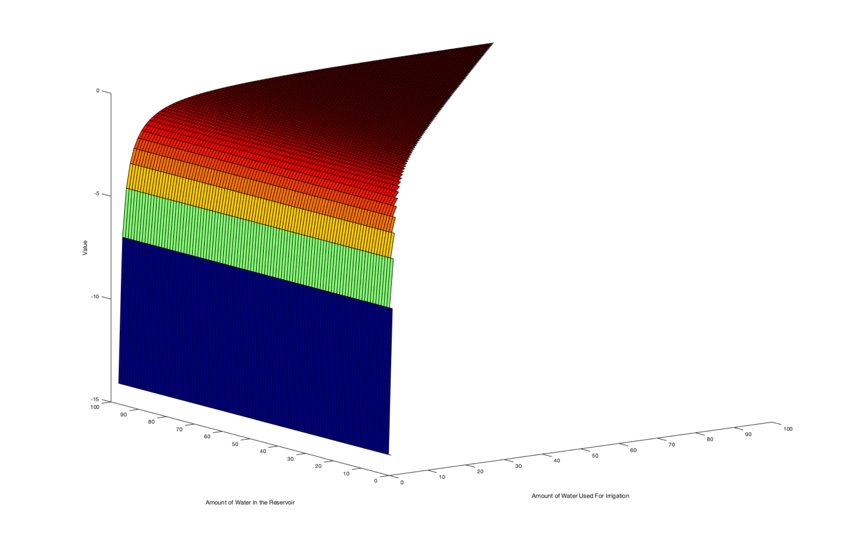
Value Function of Farmers

Slide 12
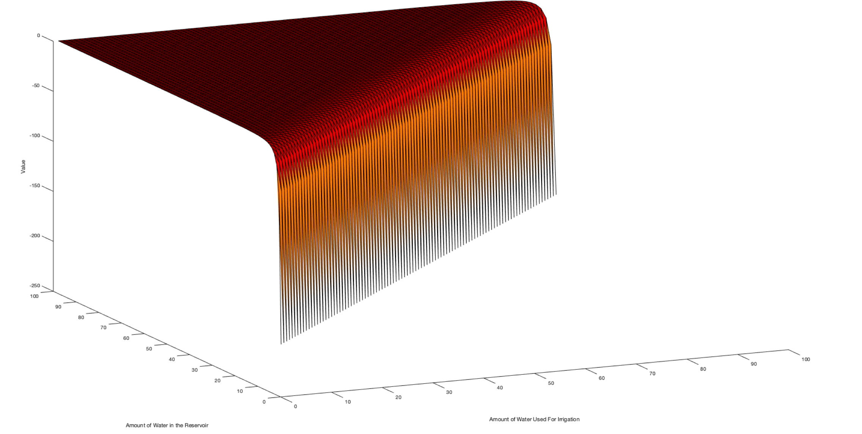
Value Function of Recreational Users

Slide 13
Thank you for your attention!

